Slide 1
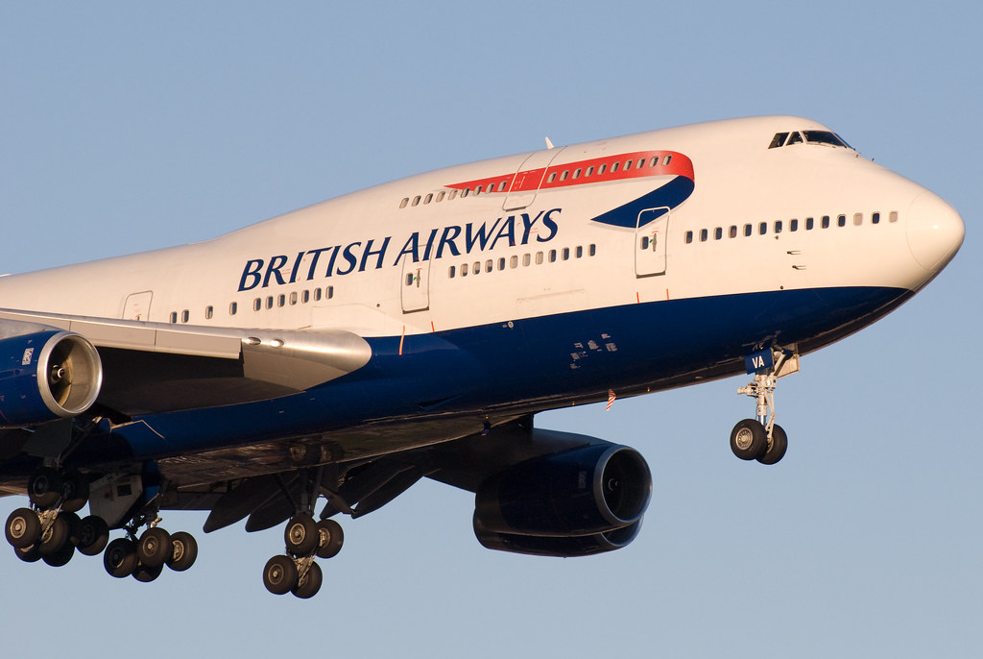
British Airways sentiment analysis
Let us delve into what people think about British Airlines!

Slide 2
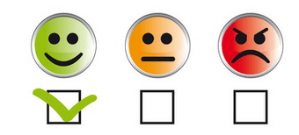
Problem Statement
In this assignment, our objective is to analyse customer sentiments to gain a deeper understanding of the general discourse surrounding our airline, British Airways. By collecting and examining customer reviews, we aim to identify common themes, areas of satisfaction, and points of dissatisfaction expressed by passengers. This analysis is crucial for providing actionable insights into how the airline is perceived in the market

Slide 3

Approach used
Sentiment Analysis: Calculated sentiment scores based on words present in the review. Identified and categorized customer reviews into positive, neutral, and negative sentiments based on the value of the sentiment score.
Weighted Analysis: Assigned weightages to reviews based on verification status, prioritizing verified reviews for a more accurate reflection of genuine customer experiences.
Visualization: Created word clouds and pie charts to visually represent sentiment distribution and popular topics in customer feedback.
Phrase Extraction: Extract frequently mentioned phrases in each sentiment category to pinpoint specific aspects of the service that are consistently praised or criticized.
Insight Generation: Generated summaries and insights from the phrases toknow what is happening in the three sentiment categories.

Slide 4
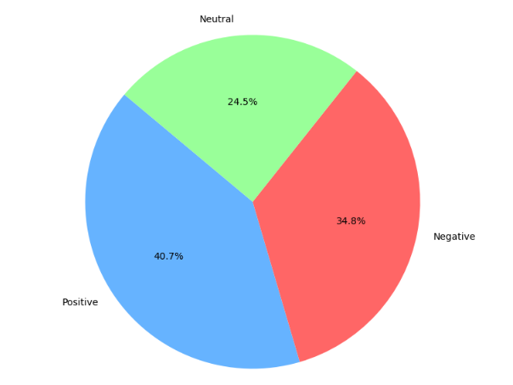
Share of sentiments
While the majority of reviews are positive, less than 50% of customer experiences are favourable, which is concerning for the airline's hospitality business. About one-third of the reviews are negative, and a quarter are neutral, indicating significant areas for improvement in customer satisfaction and service quality.

Slide 5
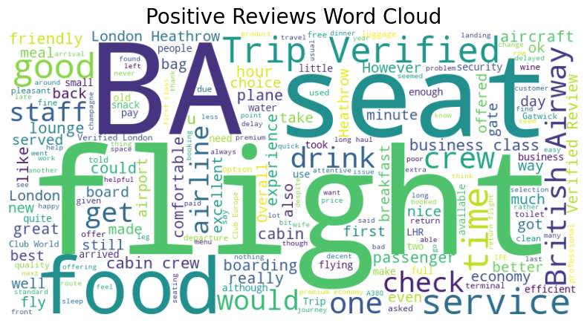
Positive Reviews Analysis
The positive sentiment phrases for British Airways reviews highlight satisfaction with the overall experience, particularly among first-time flyers and those using Avios points or Amex companion vouchers. Passengers frequently mention the benefits of flying British Airways for both short-haul business class and long-haul international routes, especially when flying from London Heathrow to New York JFK. The experience at the BA First Class check-in area is also praised. These reviews suggest that British Airways' loyalty programs, premium services, and major routes are well-regarded by customers, contributing to a positive overall perception of the airline.

Slide 6
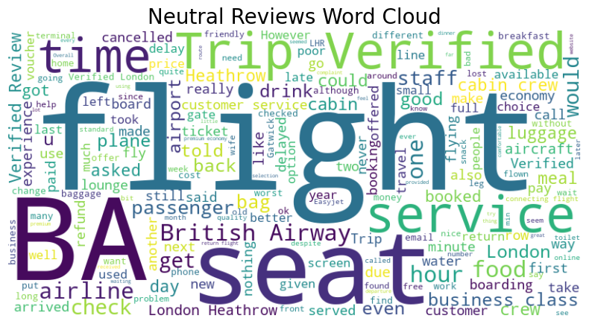
Neutral Reviews Analysis
The neutral sentiment phrases reflect a mix of standard and necessary actions taken by British Airways, such as enforcing travel policies and adapting to government advisories. Passengers mention that British Airways is still enforcing specific policies, like essential travel, as advised by the Foreign Office. The reviews also reference experiences like transiting via London Heathrow and interactions with other airlines like Qatar Airways. People appear to ne fed up of the extra rules.

Slide 7
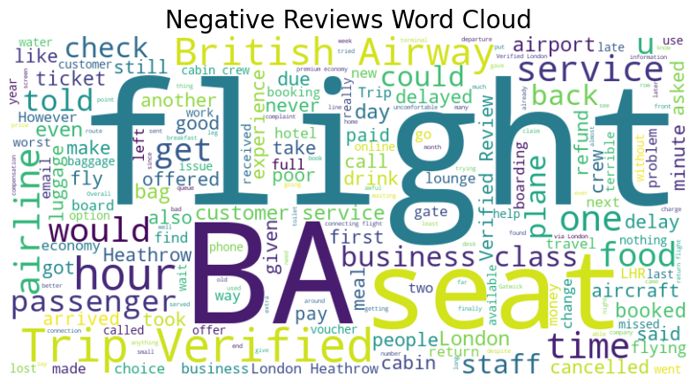
Negative Reviews Analysis
The negative sentiment phrases are focused on frustrations with customer service and operational delays. Passengers commonly cite poor customer service, including long delays, inadequate support, and a sense of neglect. There are specific complaints about flights delayed for hours, lack of assistance from British Airways staff, and dissatisfaction with the handling of issues like COVID-19 testing requirements. Some reviews compare British Airways unfavourably to low-cost carriers, particularly regarding customer service. These phrases indicate significant dissatisfaction with how British Airways manages customer relations and operational disruptions

